Slide 1

Leukemia

Slide 2

Team member
Randa Adel
Reham Refaat
Aliaa Yaseen
Amira Hussien
UNDER SUPERVISION OF
Dr\ Ibrahim E. El-Semman

Slide 3

Collecting Data

Slide 4

First Step
we choose leukemia as a disease to study its proteomics, so we search about it on google and open the first link from NCBI to get more information

Slide 5

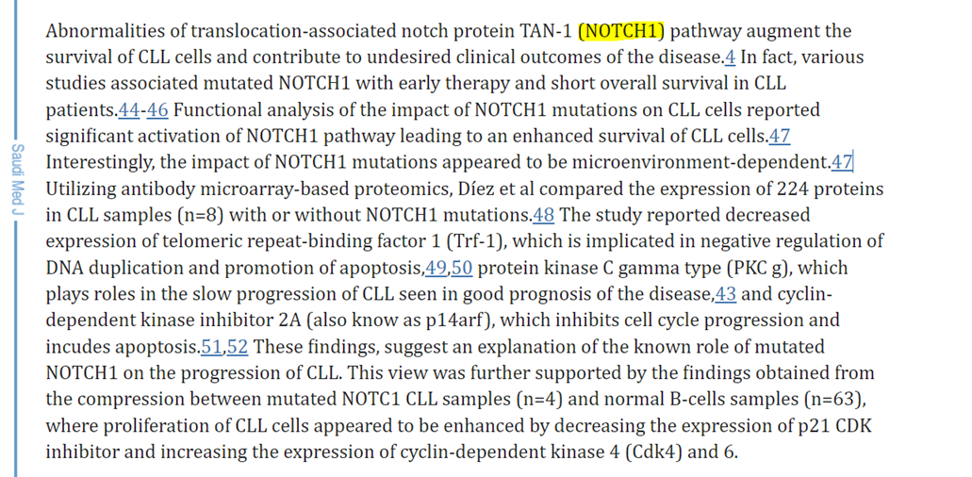
Second step
From the first link we could recognize that there is many causes affect the inhibition of Leukemia and one of the causes the absence of protein NOTCH1
Proteomics insights into the pathology and prognosis of chronic lymphocytic leukemia - PMC (nih.gov)

Slide 6
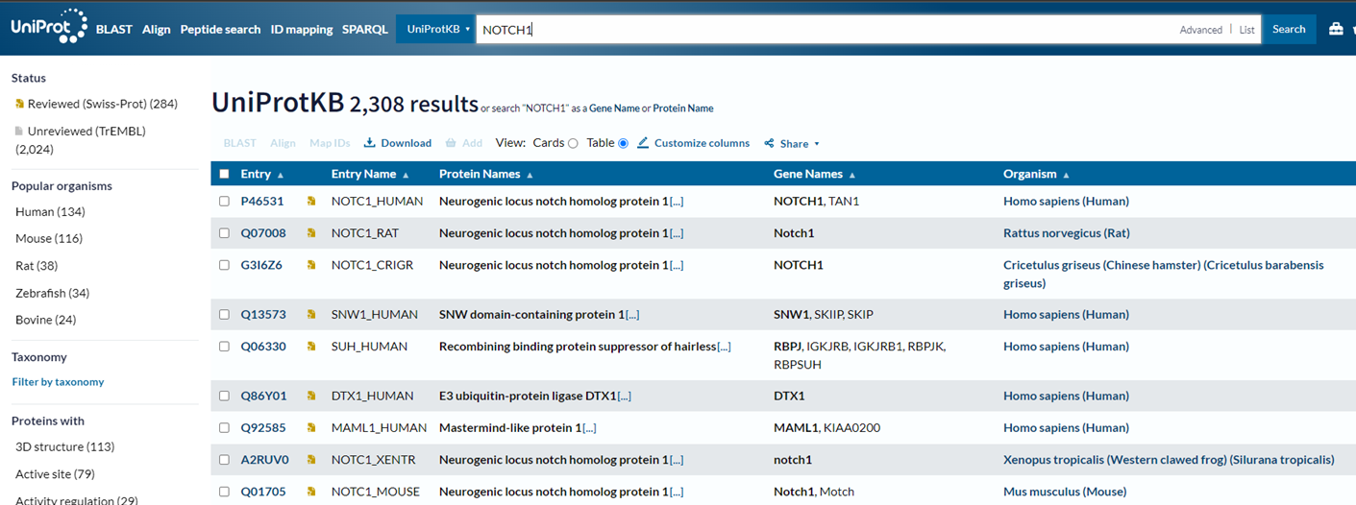
Third step
From the UniProt we write in search NOTCH1 and get the result

Slide 7
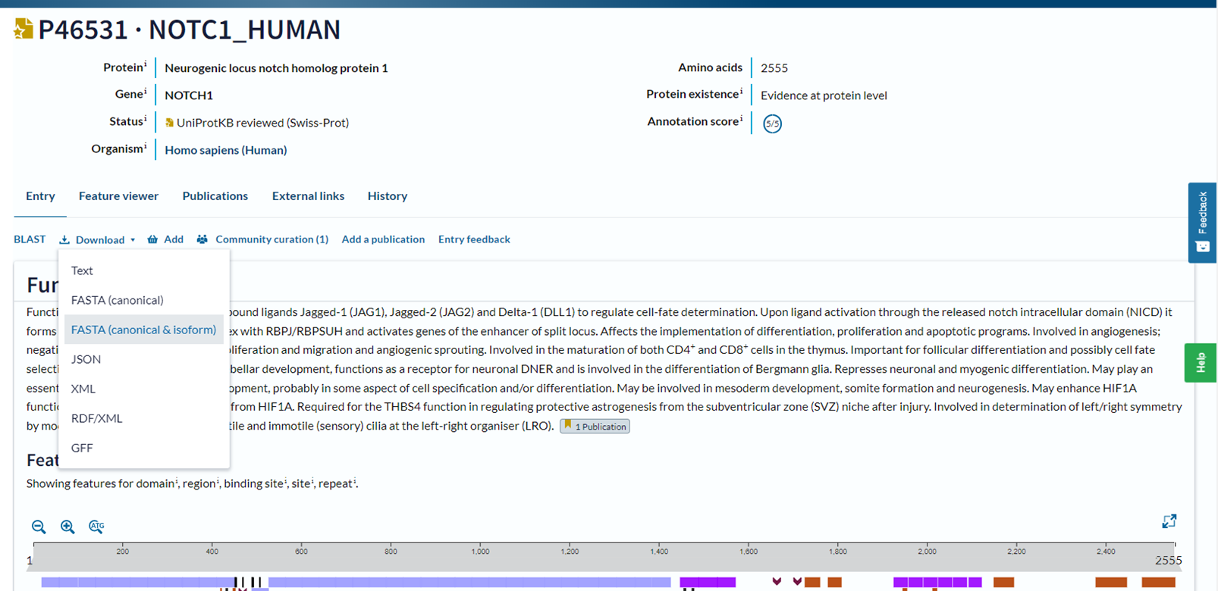
Forth step
From the first link of Homo sapiens (Human), we download the first file of FASTA format to use it as Experimental proteomics
NOTCH1 - Neurogenic locus notch homolog protein 1 - Homo sapiens (Human) | UniProtKB | UniProt

Slide 8
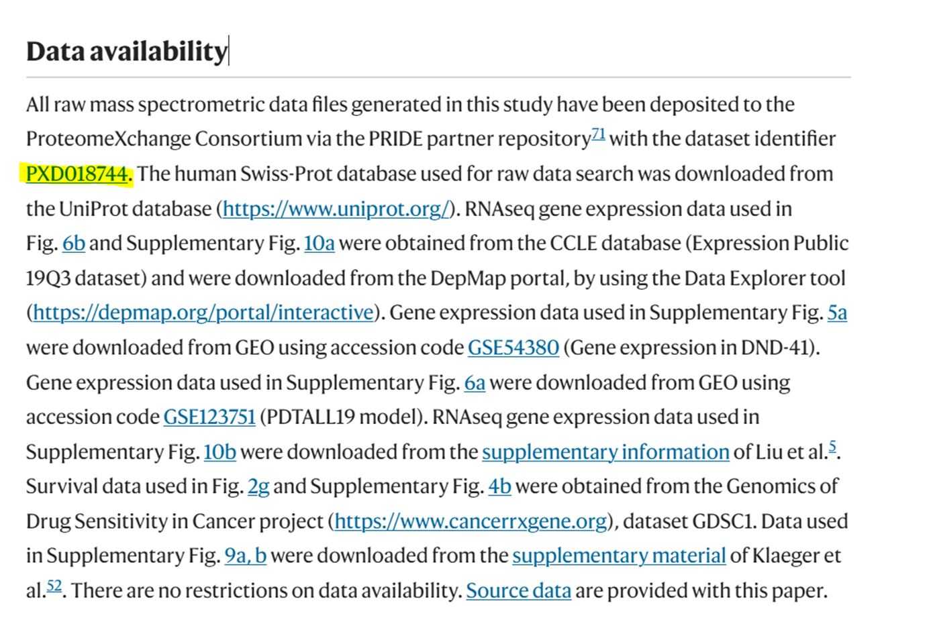
Fifth step
To get mzML file we search about this protein and we get this Identifier in PRIDE
Proteomics of resistance to Notch1 inhibition in acute lymphoblastic leukemia reveals targetable kinase signatures | Nature Communications

Slide 9
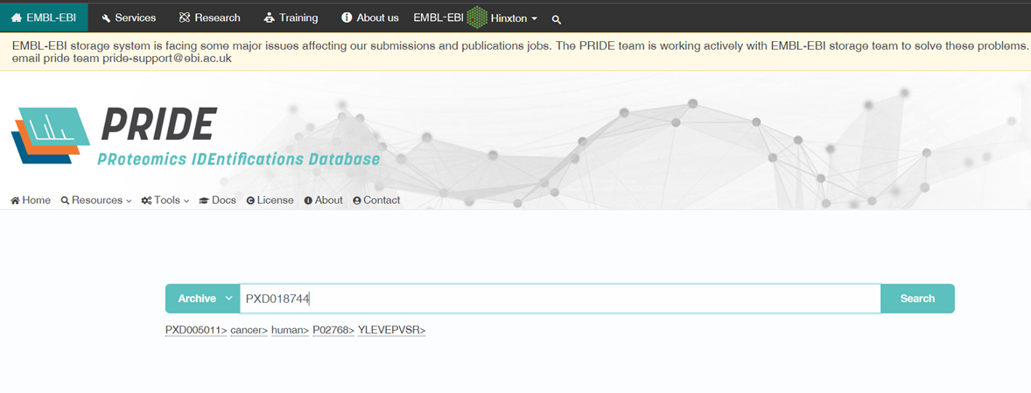
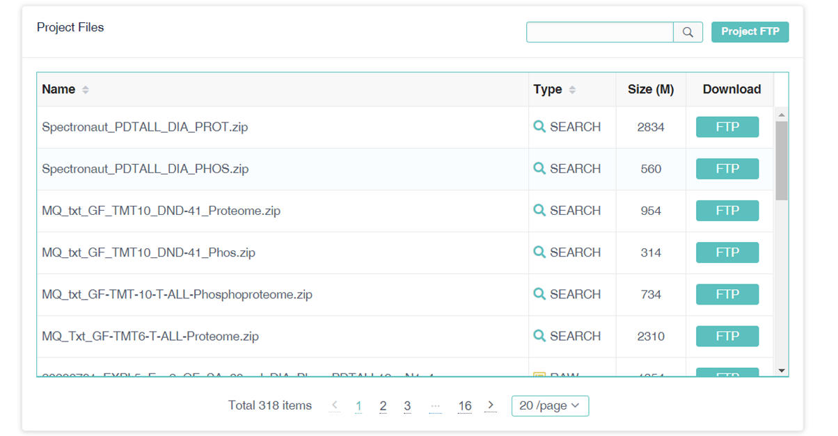
Sixth step
we search about this study in PRIDE and we get the project and download two mzML files from the project
Multilayered proteomics uncovers Notch/PKC targeting to overcome resistance to Notch inhibition in acute lymphoblastic leukemia (ebi.ac.uk)

Slide 10

We are Working in leukemia Cancer Data

Slide 11

Sample 1

Slide 12

Theoretical Peptides

Slide 13
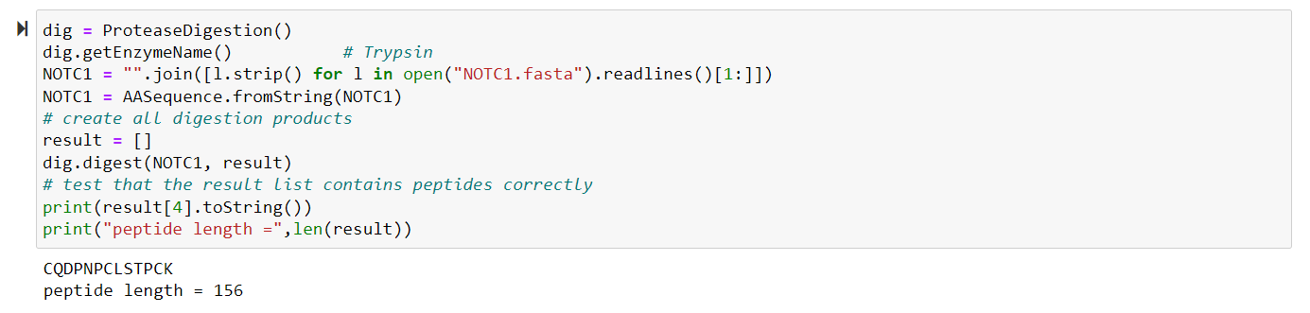
Digestion for protein in FASTA file with Trypsin (Theoretical peptides)

Slide 14
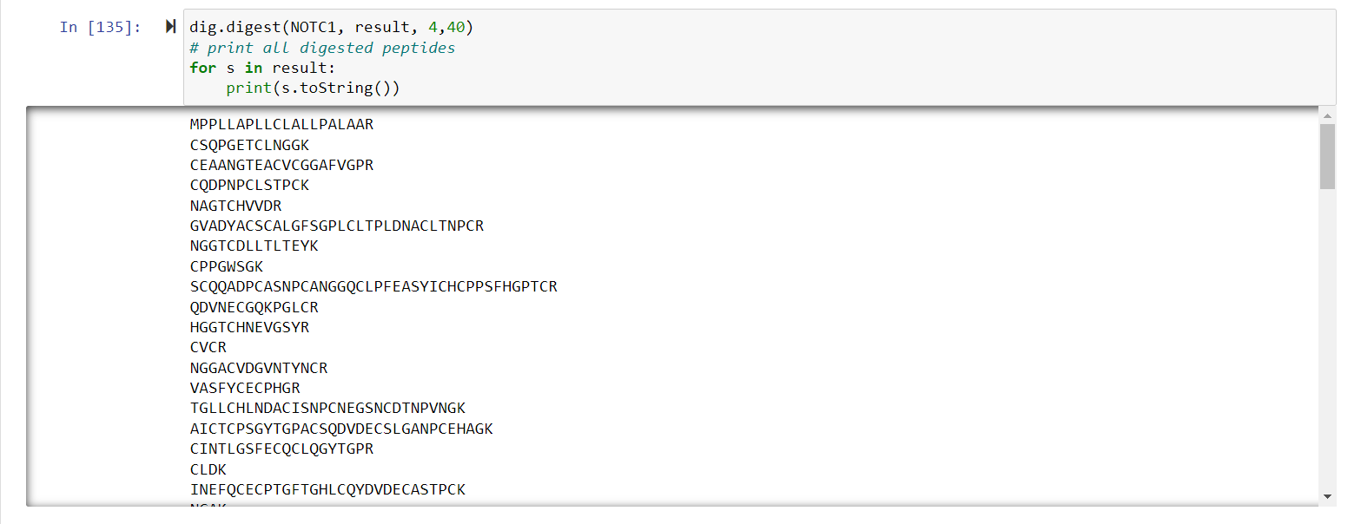
Digestion for protein in FASTA file with Trypsin (Theoretical peptides)

Slide 15
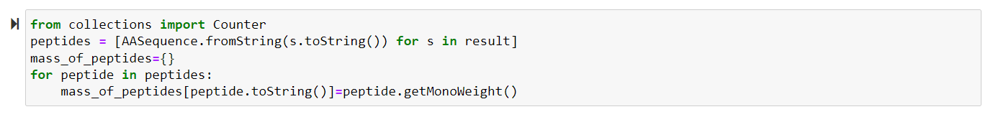
Get the Mono weight of all peptides

Slide 16
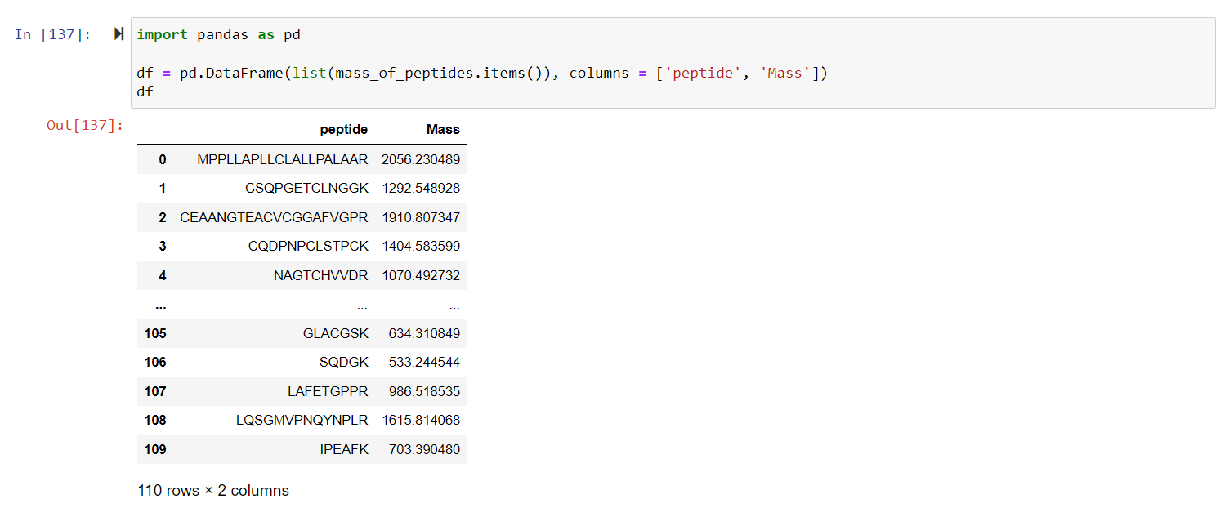
Make a data frame to store mass of each peptide

Slide 17
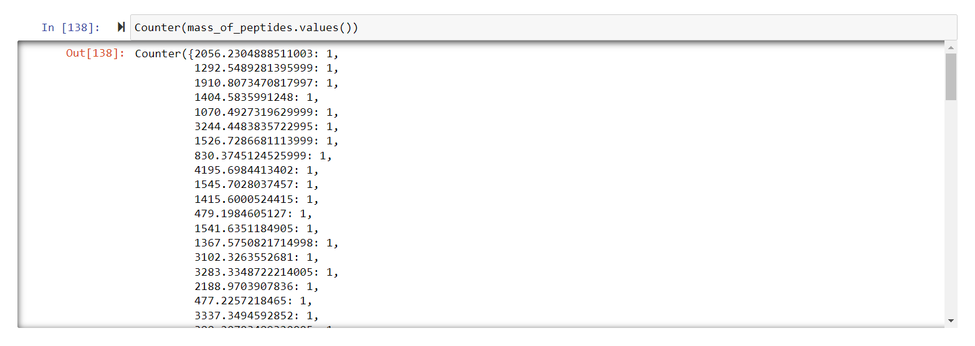
we see if mass duplicate or not

Slide 18
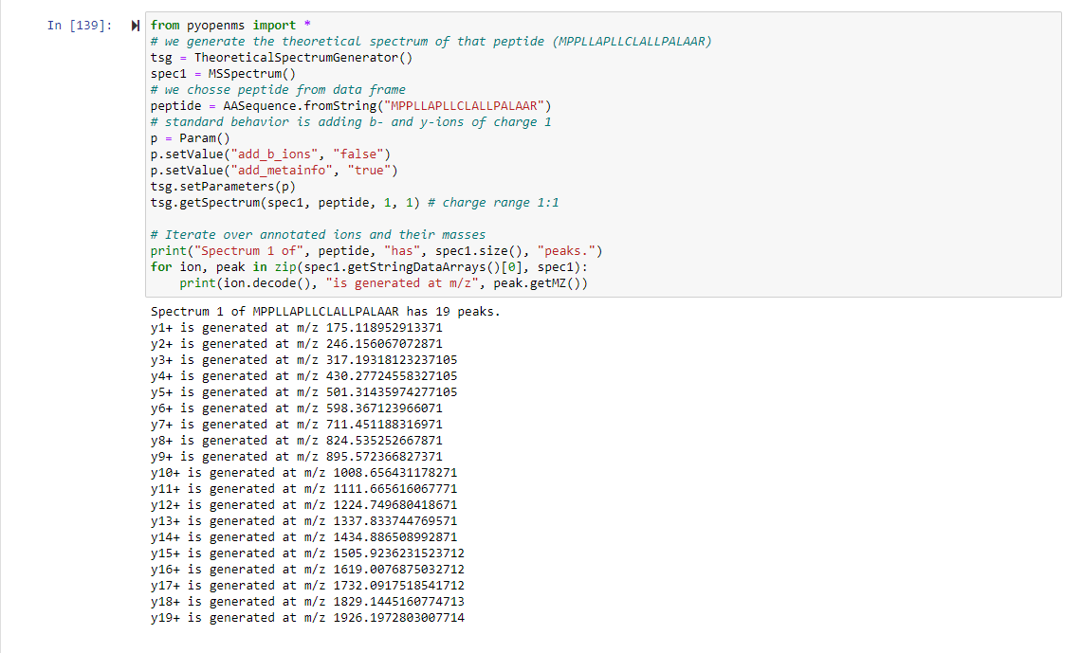
Annotation for specific peptide (MPPLLAPLLCLALLPALAAR)

Slide 19
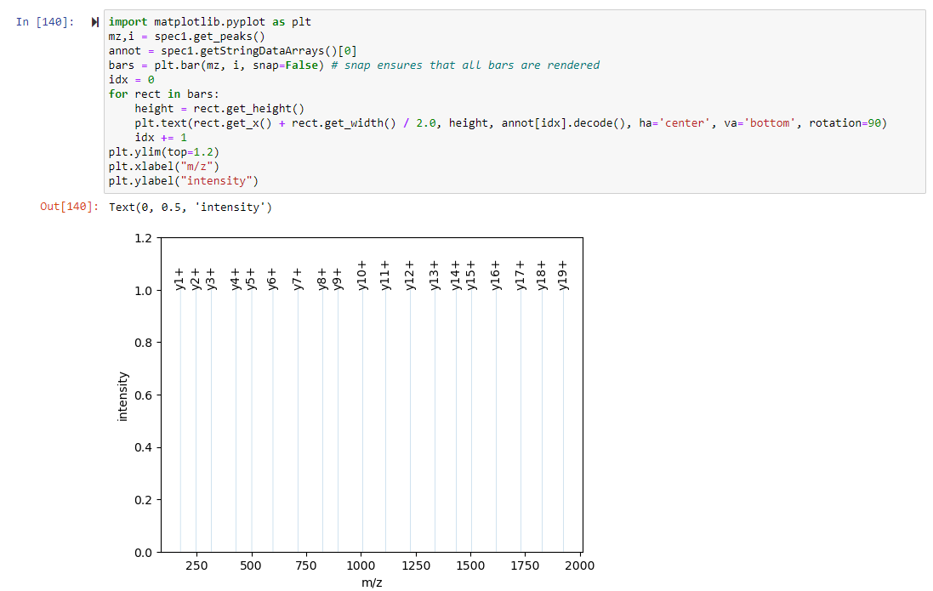
Visualization of peaks for this peptide

Slide 20
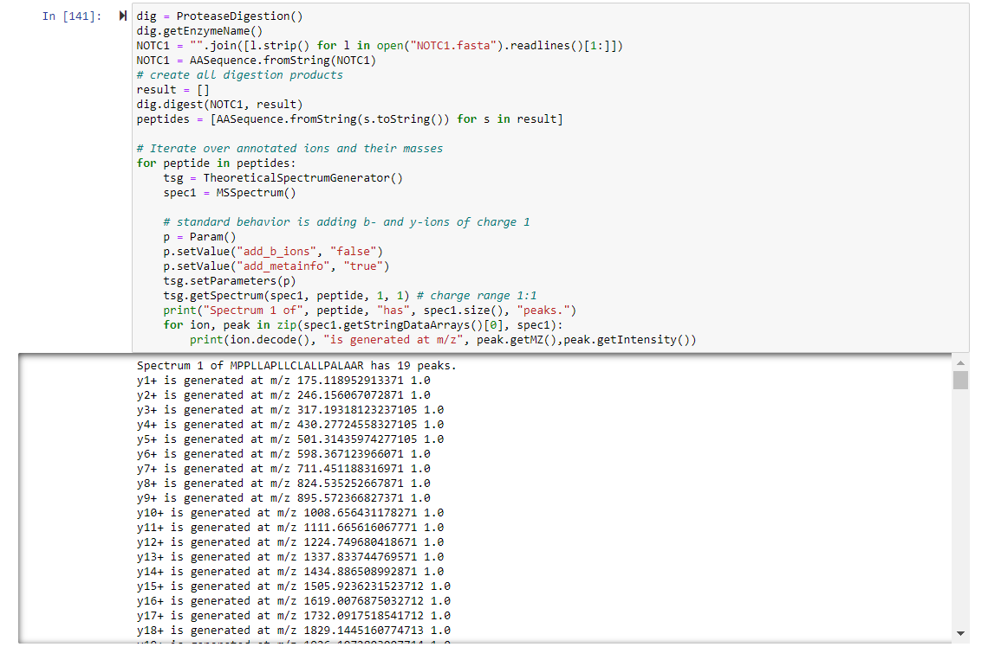
Annotation for All peptides

Slide 21
Experimental Peptides

Slide 22
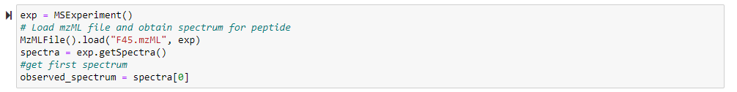
Load mzML file and spectrum for All peptides (Experimental Peptides)

Slide 23

Search Engine

Slide 24
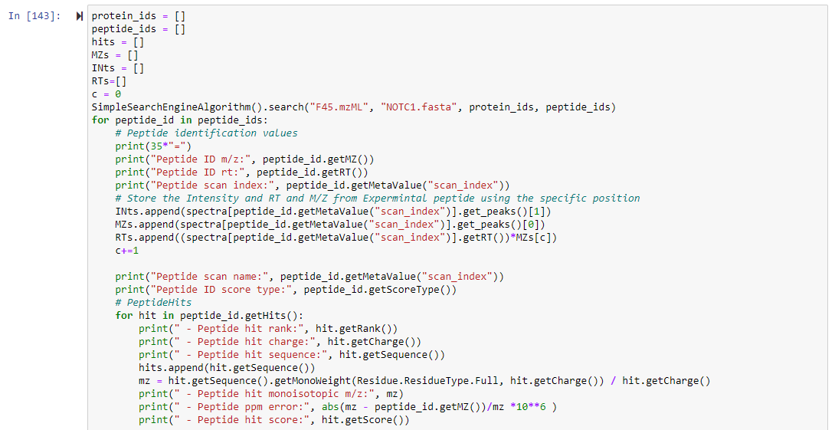
Search Engine Code to get the hits between Theoretical and Experimental

Slide 25
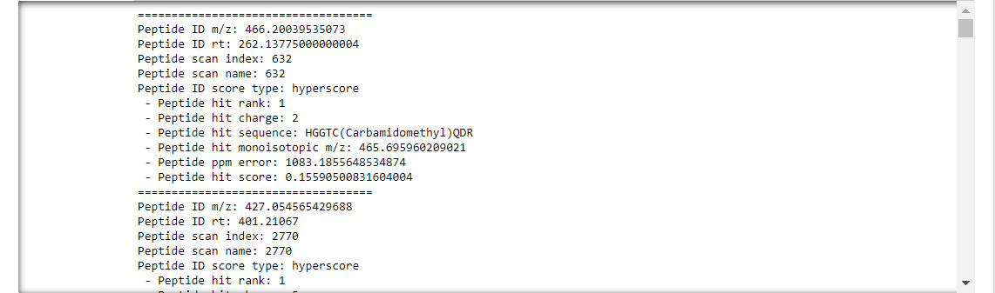
Search Engine Code to get the hits between Theoretical and Experimental result

Slide 26
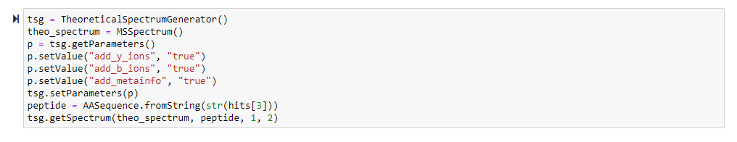
we generate the theoretical spectrum of peptide

Slide 27
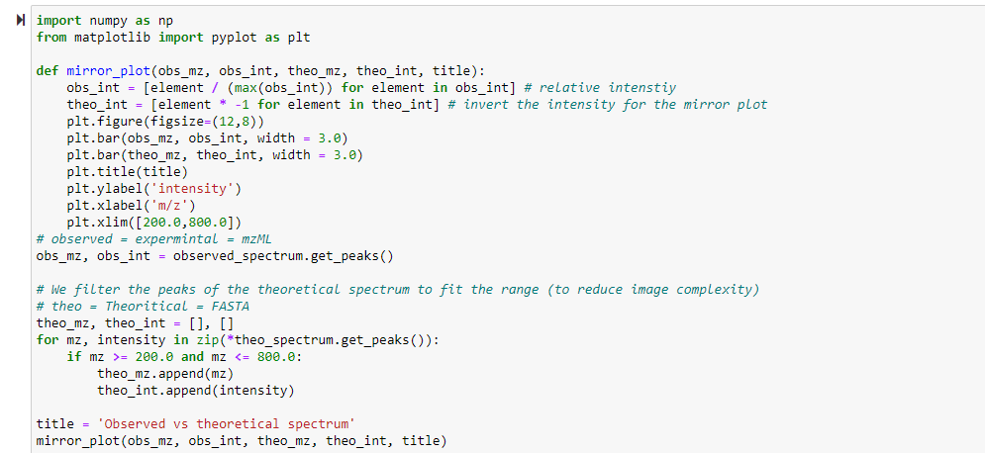
we can plot the observed and theoretical spectrum as a mirror plot

Slide 28
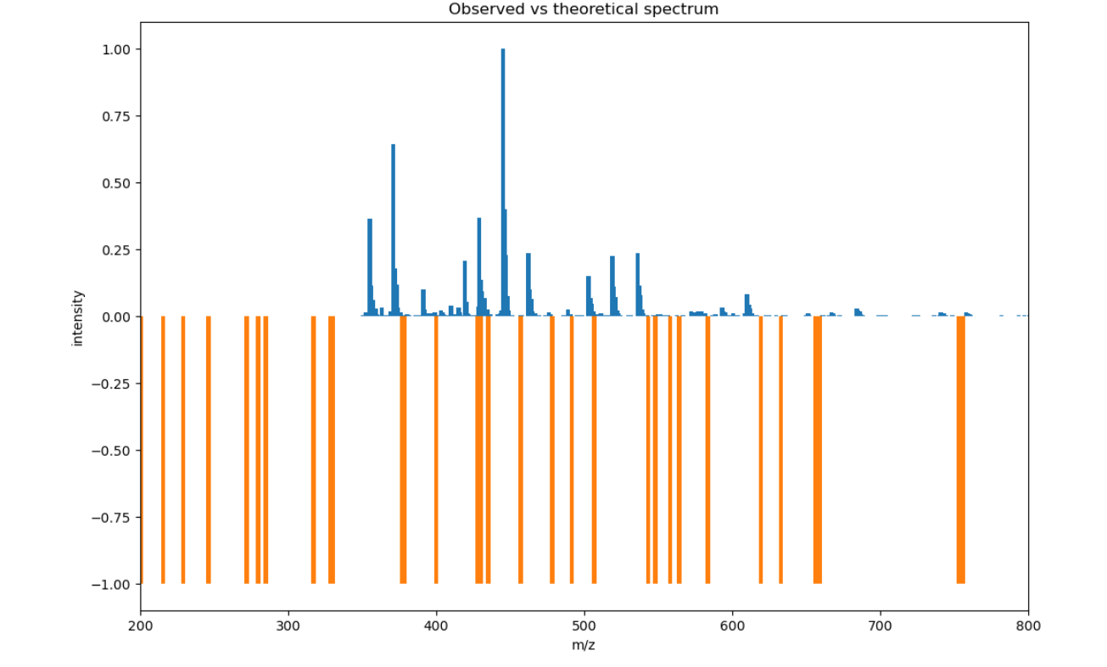
we can plot the observed and theoretical spectrum as a mirror plot result

Slide 29
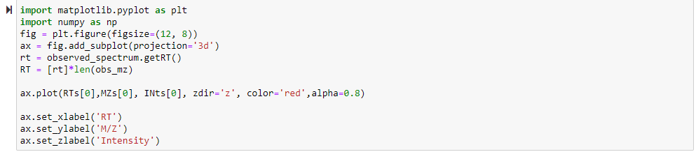
3D plot for one peptide

Slide 30
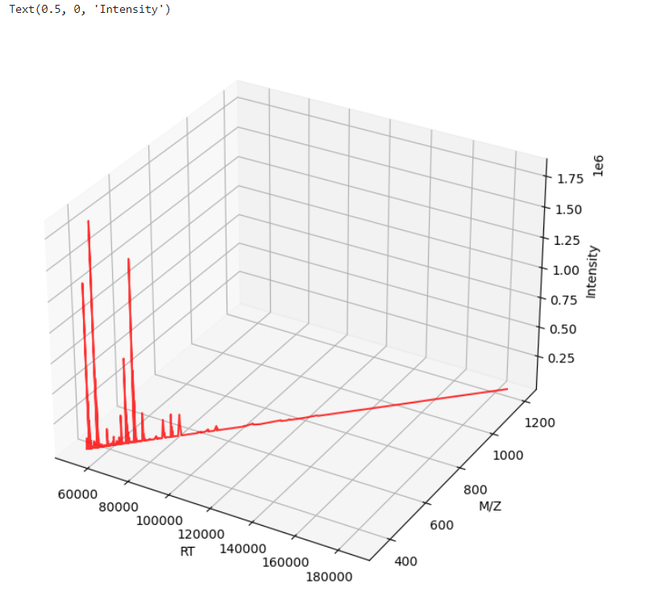
3D plot for one peptide result

Slide 31
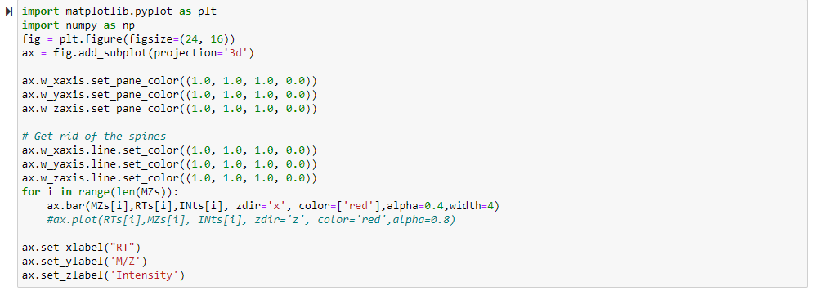
3D Bar plot for all peptide

Slide 32
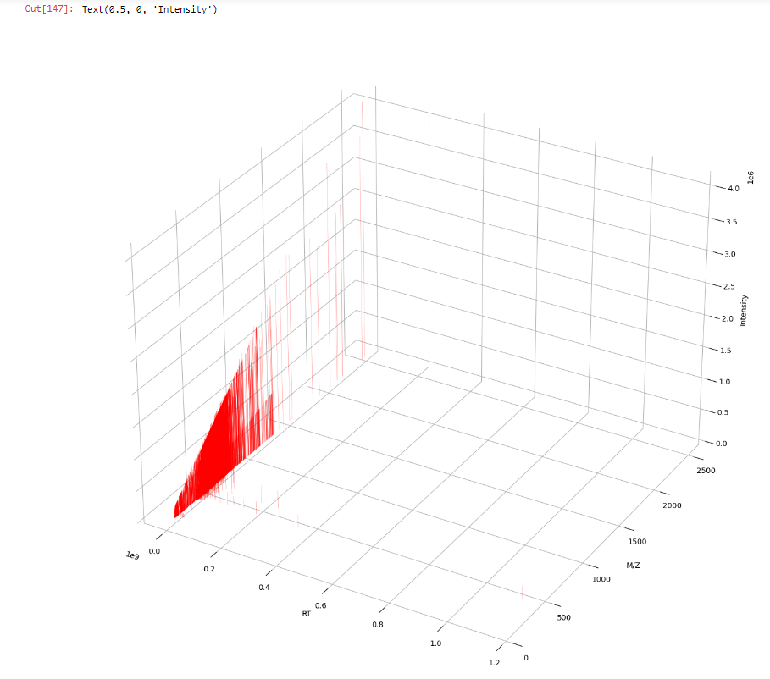
3D Bar plot for all peptide
result

Slide 33
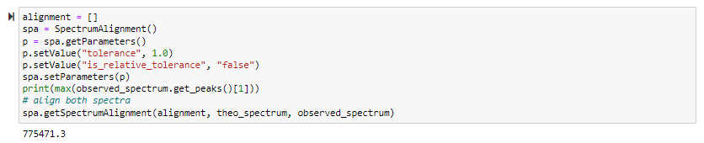
We want to find matching peaks between observed and theoretical spectrum

Slide 34
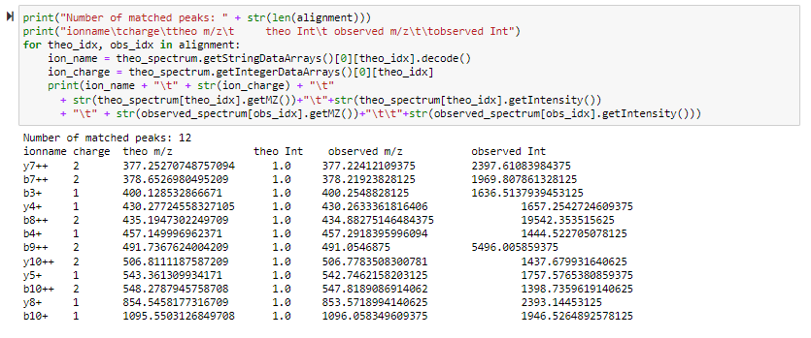
We want to find matching peaks between observed and theoretical spectrum

Slide 35
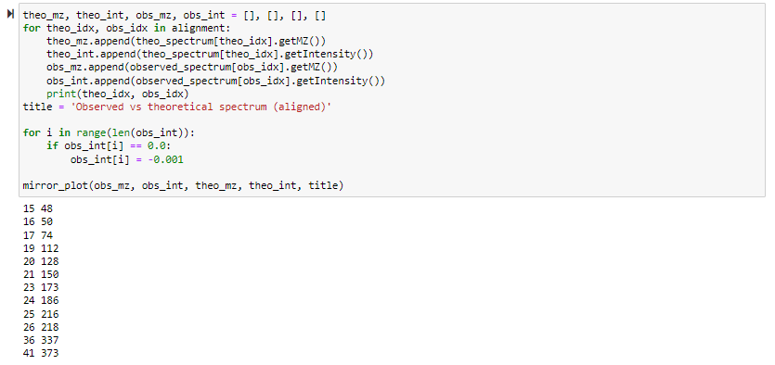
The mirror plot can also be used to visualize the aligned spectrum

Slide 36
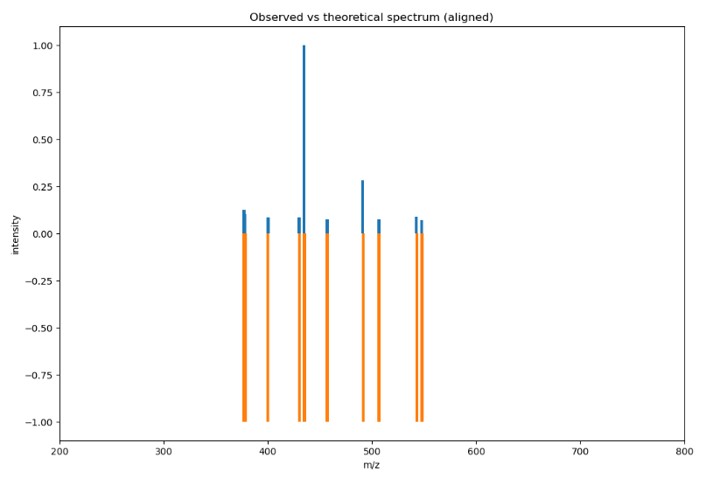
The mirror plot can also be used to visualize the aligned spectrum

Slide 37
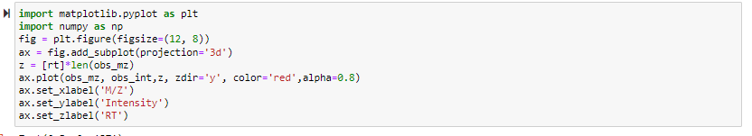
3D plot for one peptide

Slide 38
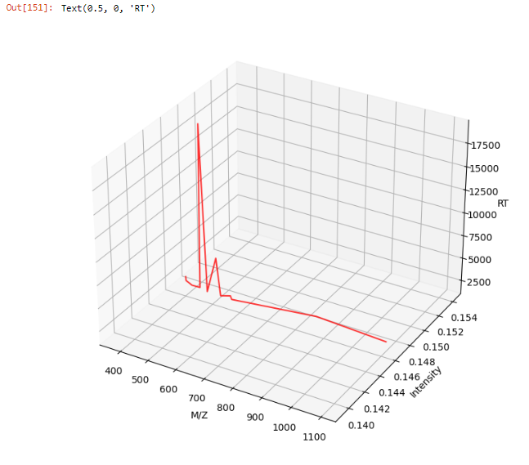
3D plot for one peptide
result

Slide 39
Sample 2

Slide 40
Theoretical Peptides

Slide 41
Digestion for protein in FASTA file with Trypsin (Theoretical peptides)

Slide 42
Digestion for protein in FASTA file with Trypsin (Theoretical peptides)

Slide 43
Get the Mono weight of all peptides

Slide 44
Make a data frame to store mass of each peptide

Slide 45
we see if mass duplicate or not

Slide 46
Annotation for specific peptide (MPPLLAPLLCLALLPALAAR)

Slide 47
Visualization of peaks for this peptide

Slide 48
Annotation for All peptides

Slide 49
Experimental Peptides

Slide 50
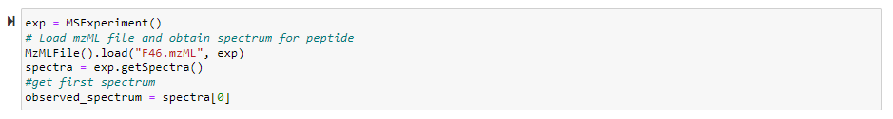
Load mzML file and spectrum for All peptides (Experimental Peptides)

Slide 51
Search Engine

Slide 52
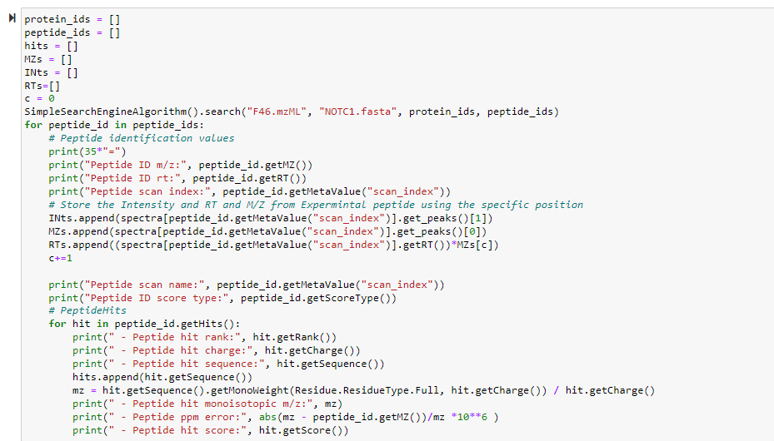
Search Engine Code to get the hits between Theoretical and Experimental

Slide 53
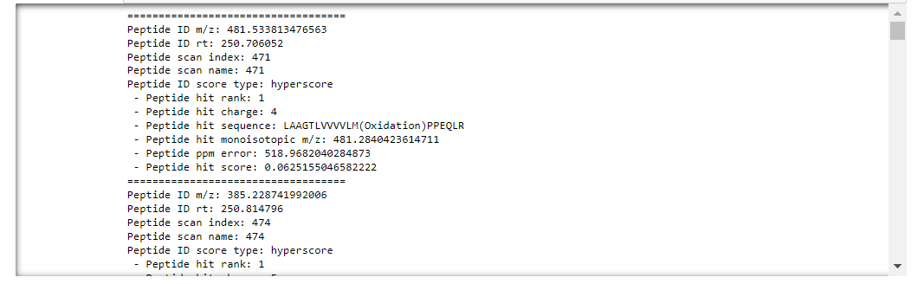
Search Engine Code to get the hits between Theoretical and Experimental result

Slide 54
we generate the theoretical spectrum of peptide

Slide 55
we can plot the observed and theoretical spectrum as a mirror plot

Slide 56
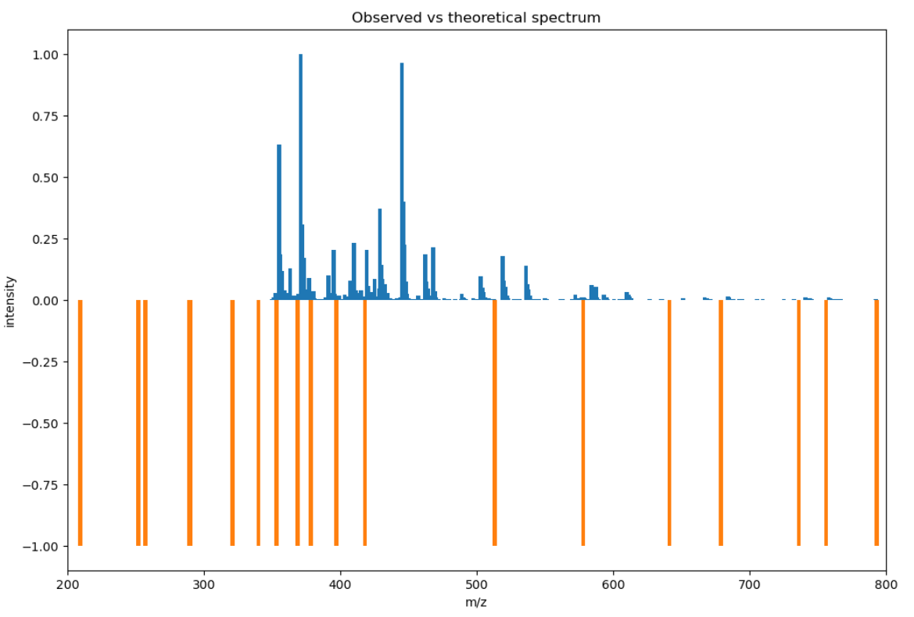
we can plot the observed and theoretical spectrum as a mirror plot result

Slide 57
3D plot for one peptide

Slide 58
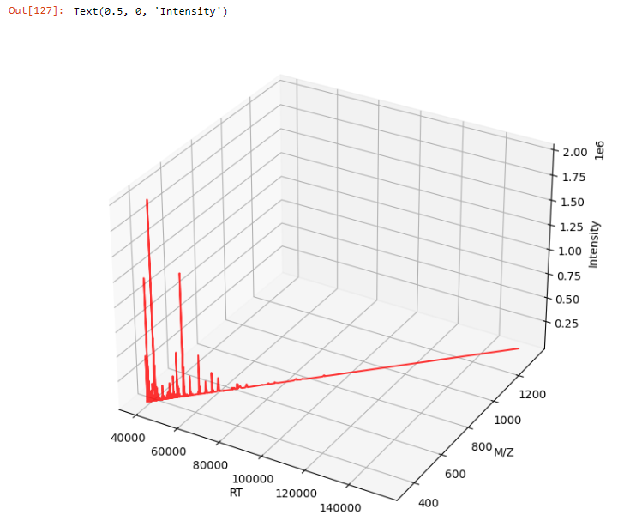
3D plot for one peptide result

Slide 59
3D Bar plot for all peptide

Slide 60
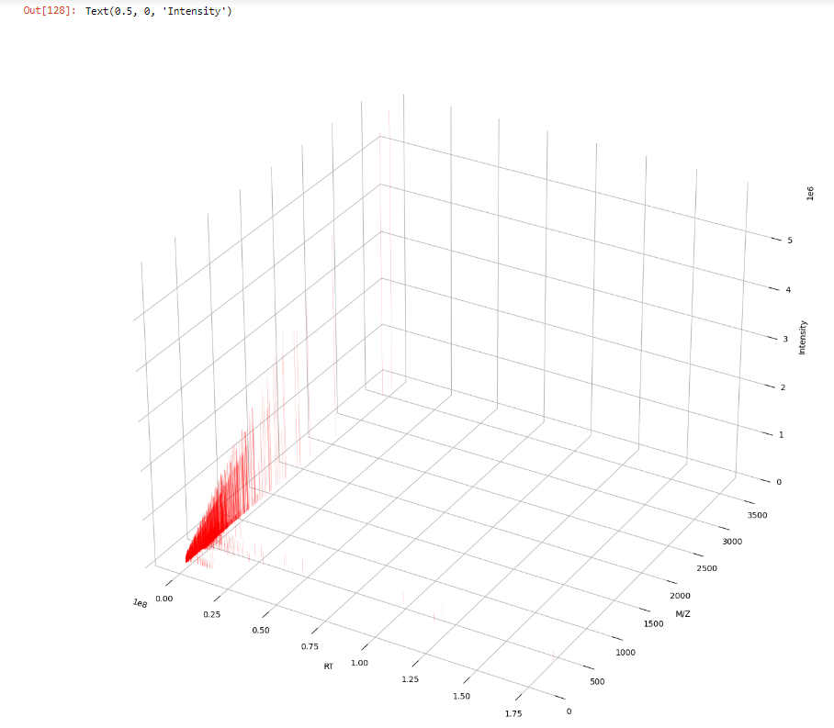
3D Bar plot for all peptide
result

Slide 61
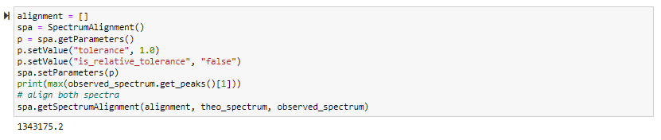
We want to find matching peaks between observed and theoretical spectrum

Slide 62
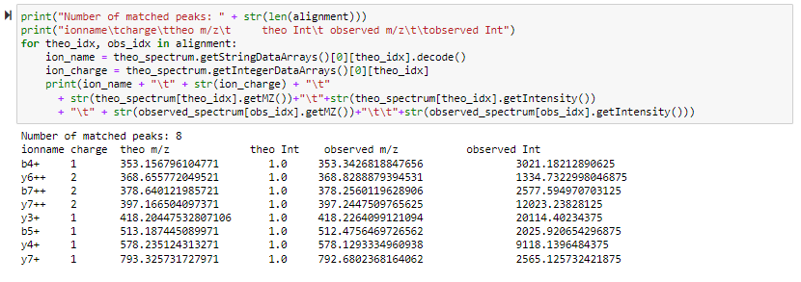
We want to find matching peaks between observed and theoretical spectrum

Slide 63
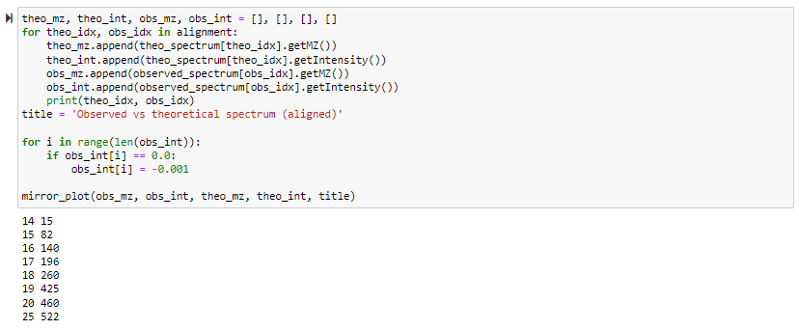
The mirror plot can also be used to visualize the aligned spectrum

Slide 64
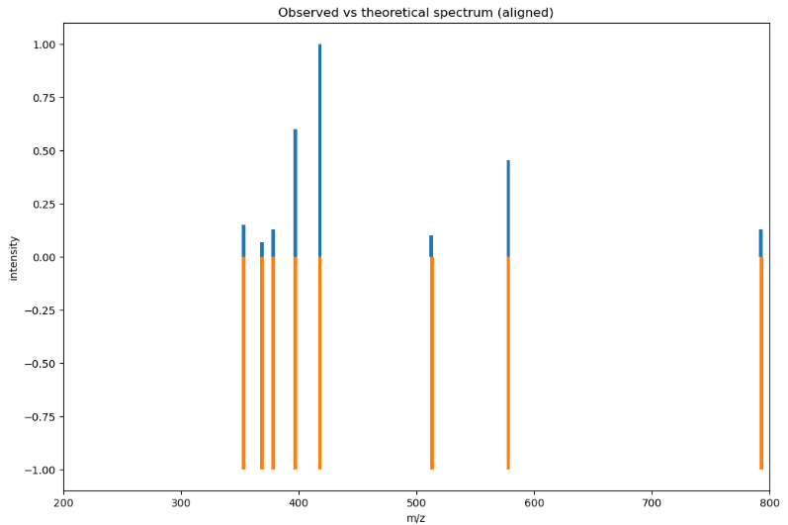
The mirror plot can also be used to visualize the aligned spectrum

Slide 65
3D plot for one peptide

Slide 66
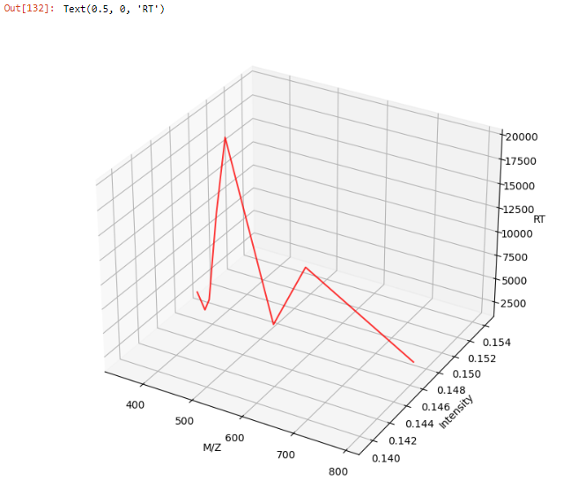
3D plot for one peptide
result

Slide 67


